Slide 1
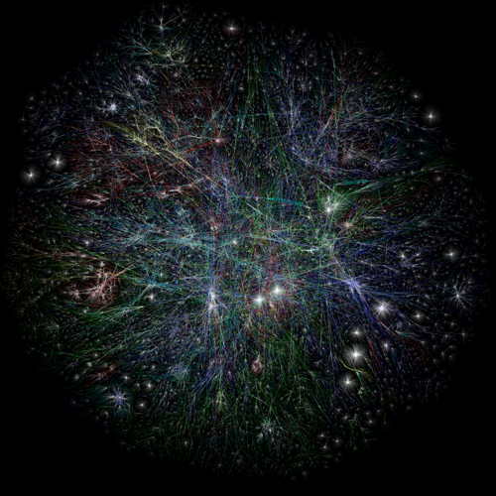
Yinghui Wu
LFCS Lab Lunch
2010.8.17
Homomorphism and Simulation
Revised for Graph Matching

Slide 2
Outline
Graph Matching Problem
State of Art
Homomorphism Revised
Bounded Simulation
Graph Queries
Conclusion

Slide 3
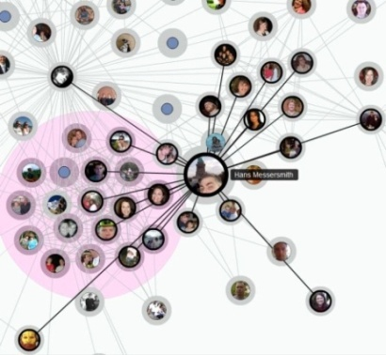
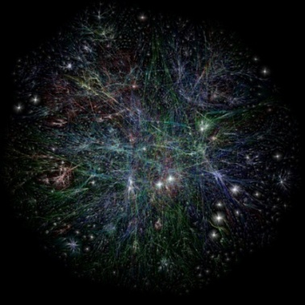
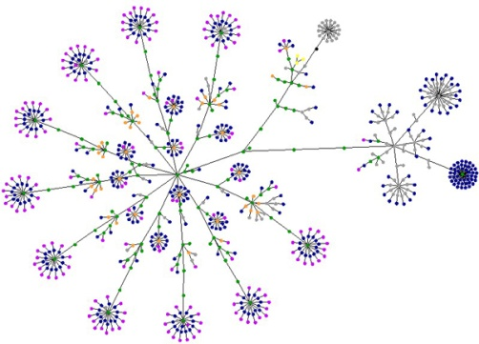
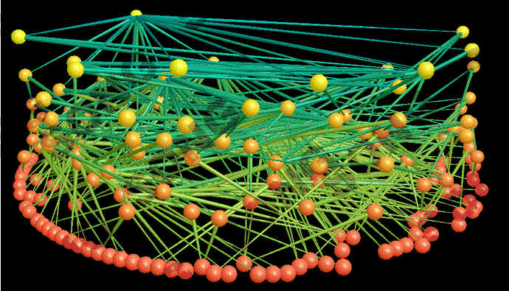
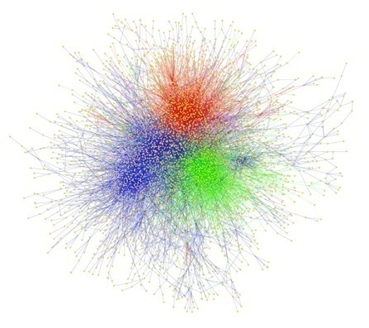
Real life graphs
Real life graphs everywhere…
  Web graph, social graph, food web…

Slide 4
Graph Matching in Real life graphs
Application
  Web mirror, schema matching, information retrieval, pattern recognition, plagiarism detection, social pattern, key work search, proximity search, web service composition…
Graph matching problem
  Input: two graphs, a similarity metric
  Output: matching relation

Slide 5
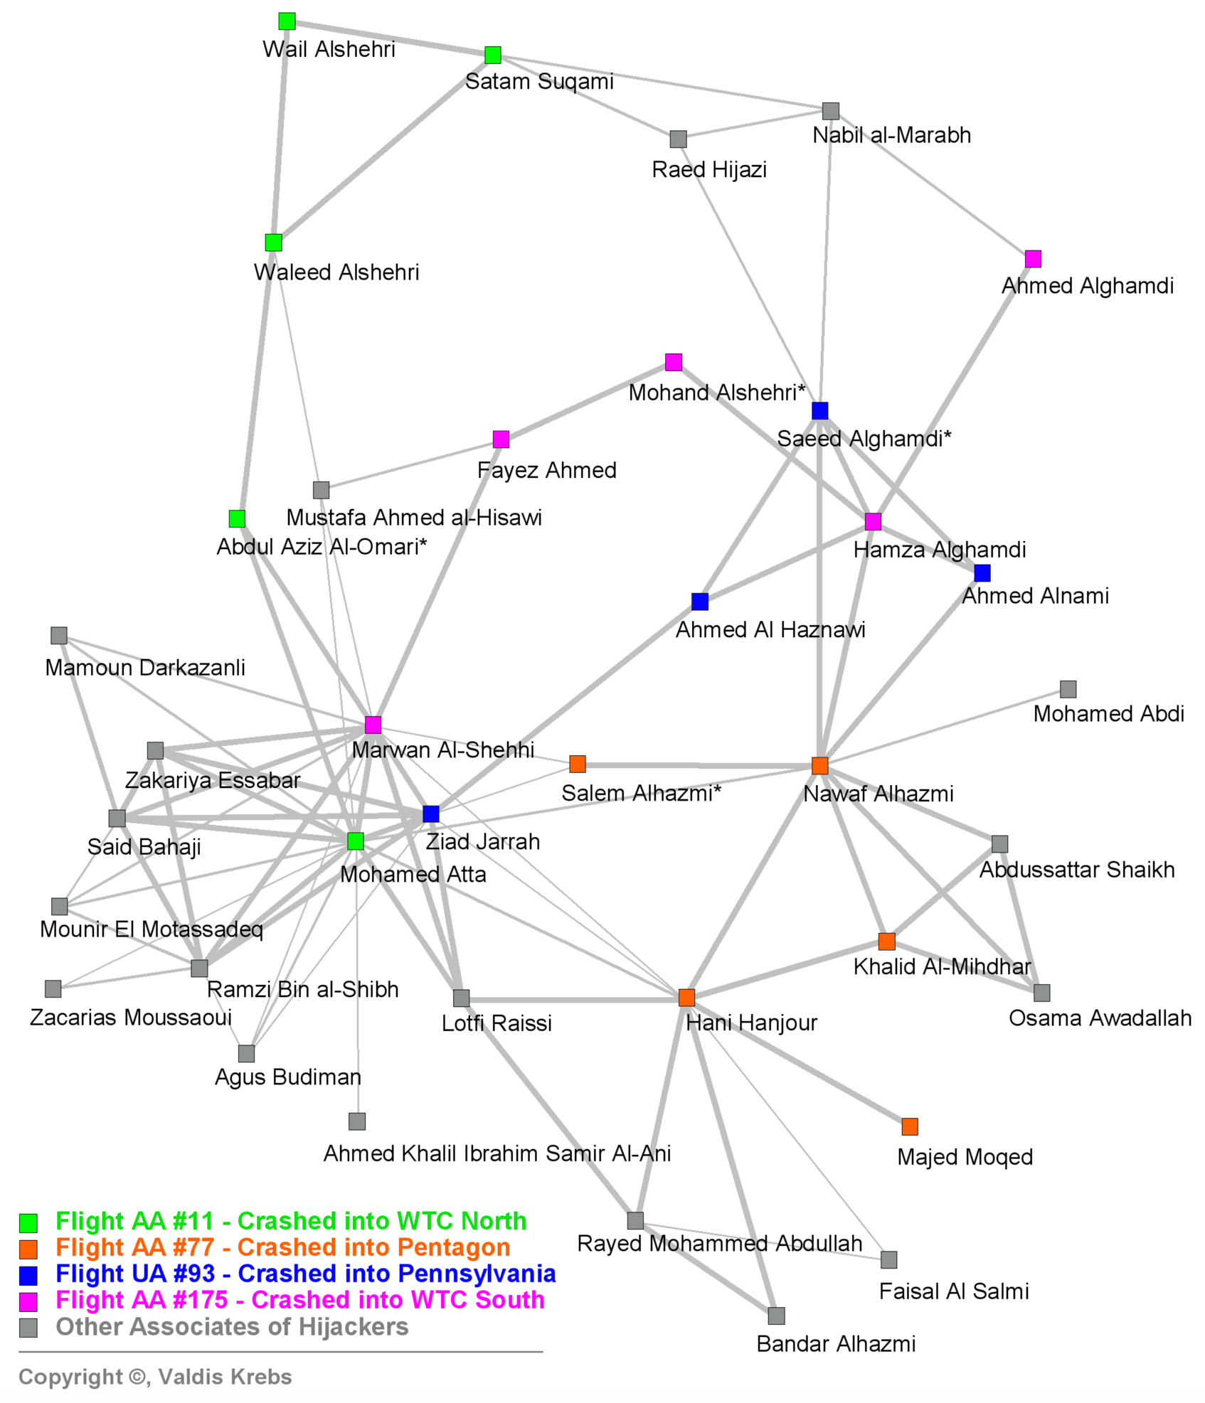
Graph Matching in Real life graphs
“Those who were trained to fly didn’t know the others. One group of people did not know the other group.” (Bin Laden)
Very long mean path length of 4.75 for a network less than 20 nodes.
Relation type: bank, business, telephone, real estate, vehicle sale, school, kinship…

Slide 6
Graph matching: state of art
Structural-based
  Graph homomorphism
  Subgraph isomorphism/Maximum common subgraph
  Edit distance
  Graph simulation
Not capable for capturing graph similarity in real life applications

Slide 7
Outline
Graph Matching Problem
State of Art
Homomorphism Revised
Bounded Simulation
Graph Queries
Conclusion

Slide 8
Graph Homomorphism Revisited
Graph homomorphism
  A graph homomorphism (resp. subgraph isomorphism) f from a graph G = (V,E) to a graph G' = (V',E'), is a mapping (resp. 1-1 mapping) from V to V' such that (u,v) in E implies (f(u),f(v)) in E’ .
  The maximum common subgraph isomorphism is to find the largest subgraph of G isomorphic to a subgraph of G’.

Slide 9
Website Matching: Example
A.index
B.index
books
audio
books
sports
digital
textbook
abook
album
categorie
bookset
CD
DVD
features
genres
schoolbooks
arts
audiobooks
albums

Slide 10
Website Matching: Example (cont.)
A.index
B.index
books
audio
books
sports
digital
textbook
abook
album
categorie
bookset
CD
DVD
features
genres
schoolbooks
arts
audiobooks
albums

Slide 11
Website Matching: Example (cont.)
A.index
B.index
books
audio
books
sports
digital
textbook
abook
album
categorie
bookset
CD
DVD
features
genres
schoolbooks
arts
audiobooks
albums

Slide 12
Homomorphism revised: a first step
Notations
  G = (V, E, L) , labeled directed graph
  Similarity matrix M over V₁ and V_{2,} a matrix of size |V₁||V₂|, with M(u,v) the similarity score of node u and v.
  Similarity threshold ξ

Slide 13
P-homomorphism
G₁ is P-homomorphism to G₂ w.r.t a similarity matrix M and threshold ξ, denoted by G₁ ≤_{(e,p)}G₂ , if there exists a mapping ρ from V₁ to V₂ such that for each v∈V₁ ,
  if ρ(v)=u, then M(u,v) ≥ ξ; and
  for each (v,v’) in E₁ , there is a nonempty path u/…/u’ in G₂ s.t. ρ(v’)=u’.
Graph homomorphism is a special case of P-homomorphism

Slide 14
1-1 P-homomorphism
G₁ is 1-1 P-homomorphism to G₂ denoted by G₁ ≤¹⁻¹_{(e,p)} G₂ , if there exists a 1-1 (injective) P-hom mapping ρ from V₁ to V₂, i.e., for any distinct nods v₁, v₂ in G₁ , ρ(v₁) ≠ ρ(v₂) .
Subgraph isomorphism is a special case of 1-1 P-homomorphism.

Slide 15
Measuring graph similarity
Let ρ be a P-hom mapping from a subgraph G₁’= (V₁’,E₁’,L₁’) of G₁ to G_{2.}
Maximum cardinality:
  Card(ρ) = |V₁’|/|V|
  Maximum cardinality problem CPH (resp. CPH¹⁻¹): find P-hom (resp. 1-1 P-hom) ρ having the maximum Card(ρ).
  Maximum Common Subgraph(MCS) is a special case of CPH¹⁻¹
Overall similarity:
  Sim(ρ) = ∑(w(v) * M(v, ρ(v)) / ∑w(v)
  Maximum overall similarity SPH (resp. CPH¹⁻¹): find P-hom (resp. 1-1 P-hom) ρ having the maximum Sim(ρ) .

Slide 16
Complexity results
Intractability
  P-Hom and 1-1 P-Hom are NP-complete.
    reduction from 3SAT
  CPH, CPH¹⁻¹, SPH, SPH¹⁻¹ are NP-hard.
    reduction from X3C
Approximation hardness
  Unless P=NP, CPH, CPH¹⁻¹, SPH, SPH¹⁻¹ are not approximable within O(1/n^{1-ε}) for any constant ε, with n the node number of input graphs.
  approximation factor preserving reduction (AFP-reduction) from maximum weighted independent set problem

Slide 17
Approximation Algorithms
Approximation ratio
  CPH, CPH¹⁻¹, SPH, SPH¹⁻¹ are all approximable within
  O(log² (|V₁||V₂|)/ (|V₁||V₂|))
Proof: AFP-reduction to WIS.
greedy based approximation algorithm:
  O (|V₁|³ |V₂|²+|V₁||E₁||V₂|³)

Slide 18
Approximation Algorithm for CPH
Algorithm compMaxCard(G₁,G₂,M, ξ)
  Initialize matching list for each node in G₁
  Start from a match pair, recursively chooses and include new matches to the match set until it can no longer be extended, via a greedy strategy.
  Intuitively, compMaxCard approximately finds the maximum clique in a revised product graph of G₁ and the transitive closure of G₂ without constructing it directly.

Slide 19
Running example
A.index
B.index
books
audio
books
sports
digital
textbook
abook
album
categorie
bookset
CD
DVD
features
genres
schoolbooks
arts
audiobooks
albums

Slide 20
Running example(cont)
A.index
B.index
books
audio
books
sports
digital
textbook
abook
album
categorie
bookset
CD
DVD
features
genres
schoolbooks
arts
audiobooks
albums

Slide 21
Running example(cont)
A.index
B.index
books
audio
books
sports
digital
textbook
abook
album
categorie
bookset
CD
DVD
features
genres
schoolbooks
arts
audiobooks
albums

Slide 22
Running example(cont)
A.index
B.index
books
audio
books
sports
digital
textbook
abook
album
categorie
bookset
CD
DVD
features
genres
schoolbooks
arts
audiobooks
albums

Slide 23
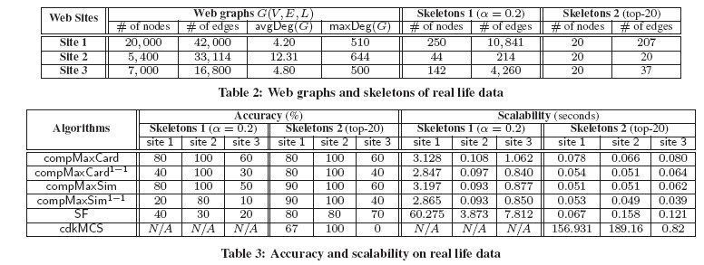
Experiment Results

Slide 24
Outline
Graph Matching Problem
State of Art
Homomorphism Revised
Bounded Simulation
Conclusion

Slide 25
Graph pattern matching: Example
AI
Med
Med
*
3
*
CS
2
Bio
DB
Gen
Chem
3
2
Soc
Soc
Eco
Collaboration Network Pattern Matching

Slide 26
Graph pattern matching: Example
AI
Med
Med
*
3
*
CS
2
Bio
DB
Gen
Chem
3
2
Soc
Soc
Eco
Collaboration Network Pattern Matching

Slide 27
Graph Pattern Matching
pattern graph P = (V_{p}, E_{p}, f_{v}, f_{e})
  f_{v} = (A op a)
  f_{e} : interger k or
data graph G = (V, E, f_{A})
  f_{A} : assigns attribute/value list to each node in data graph
‘*’

Slide 28
Simulation revised
Bounded Simulation
  data graph G = (V, E, f_{A}) matches the pattern P = (V_{p}, E_{p}, f_{v}, f_{e}), denoted by P G, if there exists a binary relation S from V_{p} to V such that for each (u, v)∈ S,
    f_{A} (v) satisfies f_{v} (u),
    for each (u,u’) in E_{p} , there is a nonempty path ρ = v/…/v’ in G s.t.
      (u’,v’) ∈ S, and
      len(ρ) ≤ k if f_{e} (u,u’) = k
▽

Slide 29
Maximum match
For any graph G and pattern P, if P G, then there is a unique maximum match in G for P.
▽

Slide 30
Result Graph
Med
Med
1
*
3
3
*
Gen
2
2
2
CS
Bio
1
DB
3
2
3
3
Eco
2
1
Soc
Soc
Collaboration network: Result graph

Slide 31
Computing Bounded Simulation
The graph pattern matching problem: given any data graph G and pattern graph P, find the maximum match in G for P if P G.
The graph pattern matching problem can be solved in cubic time.
▽

Slide 32
Computing Bounded Simulation
Algorithm Match (P,G)
  compute the distance matrix M of G
  Initialize candidate matches for each pattern node u
  Iteratively refine the candidate set of u according to each edge (v,u) in P until a fixpoint is reached, in a bottom up way
  collect the matching result
Match (P,G) runs in O(|V||E| + |E_{p}||V|² + |V_{p}||V|)

Slide 33
Running example
AI
Med
Med
*
3
*
CS
2
Bio
DB
Gen
Chem
3
2
Soc
Soc
Eco
Step 1: Initialize candidate sets for each pattern node

Slide 34
Running example (cont.)
AI
Med
Med
*
3
*
CS
2
Bio
DB
Gen
Chem
3
2
Soc
Soc
Eco
Step 2: for each edge (u,v) in P, refine candidate set of u
w.r.t v, fe(u,v) and candidates of v

Slide 35
Running example (cont.)
AI
Med
Med
*
3
*
CS
2
Bio
DB
Gen
Chem
3
2
Soc
Soc
Eco
Step 2: for each edge (u,v) in P, refine candidate set of u
w.r.t v, fe(u,v) and candidates of v

Slide 36
Running example (cont.)
AI
Med
Med
*
3
*
CS
2
Bio
DB
Gen
Chem
3
2
Soc
Soc
Eco
Step 2: for each edge (u,v) in P, refine candidate set of u
w.r.t v, fe(u,v) and candidates of v

Slide 37
Running example (cont.)
AI
Med
Med
*
3
*
CS
2
Bio
DB
Gen
Chem
3
2
Soc
Soc
Eco
Step 2: for each edge (u,v) in P, refine candidate set of u
w.r.t v, fe(u,v) and candidates of v

Slide 38
Running example (cont.)
AI
Med
Med
*
3
*
CS
2
Bio
DB
Gen
Chem
3
2
Soc
Soc
Eco
Step 3: result collection

Slide 39
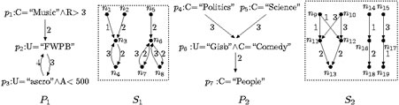
Experiment Results

Slide 40
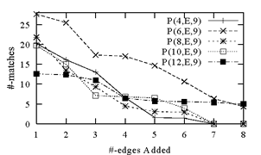
Experiment Results (cont.)

Slide 41
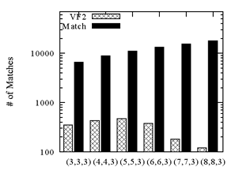
Experiment Results (cont.)

Slide 42
Conclusion
Traditional homomorphism and simulation based graph matching is not capable for capturing real life graph similarity
(1-1) P-homomorphism, edge to path matching, provable guarantees on match quality;
Bounded simulation, specifying bounded connectivity, PTIME

Slide 43
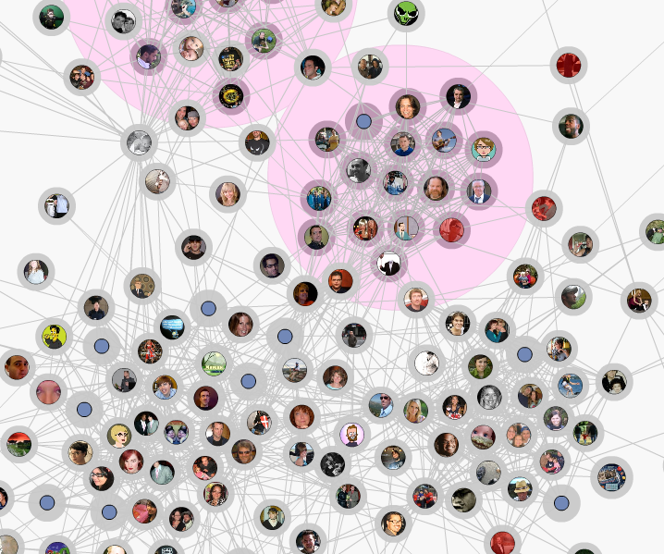
Thank you !

